Slide 1

DEPARTMENT OF COMPUTER SCIENCE AND ENGINEERING
CS23533- FOUNDATIONS OF ARTIFICIAL INTELLIGENCE
ACY 2026-27
III YEAR- V SEM
PROJECT FINAL REVIEW
SMART TRAFFIC NAVIGATION SYSTEM
DATE: 5th November 2026
BATCH NO :
TEAM No: 11
MEMBER 1 REG : Abenanthan P (240701005)
MEMBER 2 REG : Aayam Subedi (240701003)

Slide 2
ABSTRACT
The Smart Traffic Navigation System uses the A* search algorithm to find suitable routes between two locations.
The road network is represented as a weighted graph, where locations are nodes and roads are edges with travel costs.
The system displays the selected route, total travel cost and explored locations through a graphical interface.
The system supports road blocking and dynamically recalculates routes based on the updated road network.
The project demonstrates the practical application of artificial intelligence in intelligent route planning and cost-based navigation

Slide 3
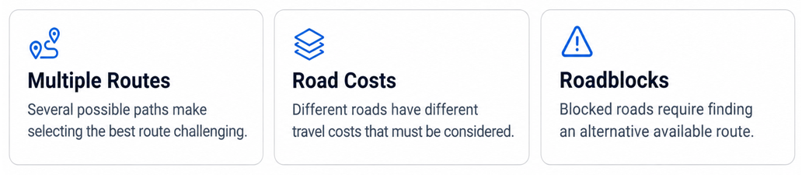
PROBLEM STATEMENT
Traffic congestion, roadblocks, and increasing travel time make route selection challenging. Finding an optimal route locations is challenging when multiple roads have different travel costs and availability. An efficient navigation approach is required to identify the minimum-cost path and handle changes in road connectivity.

Slide 4
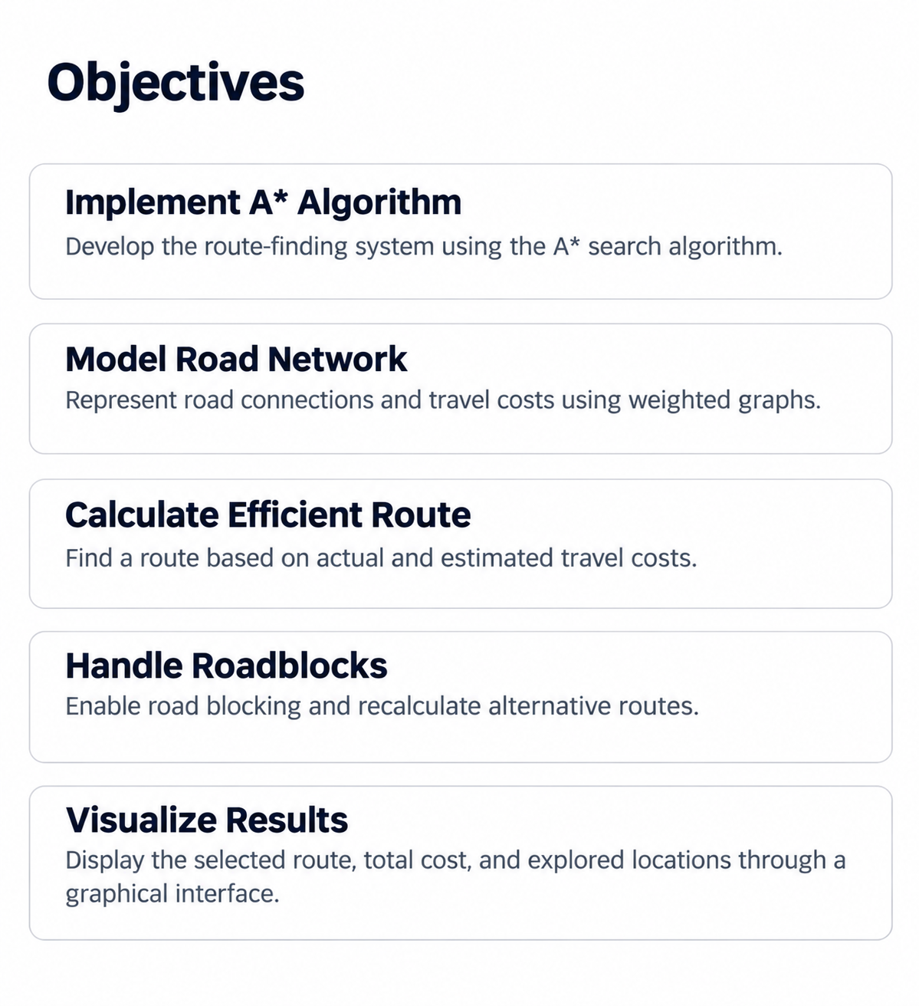
INTRODUCTION
The Smart Traffic Navigation System provides an intelligent approach to route planning by using the A* search algorithm.
It models the road network as a weighted graph, where locations are represented as nodes and road connections as edges with travel costs.
The system evaluates available paths to identify a suitable route and adapts to road closures by recalculating alternative paths.

Slide 5
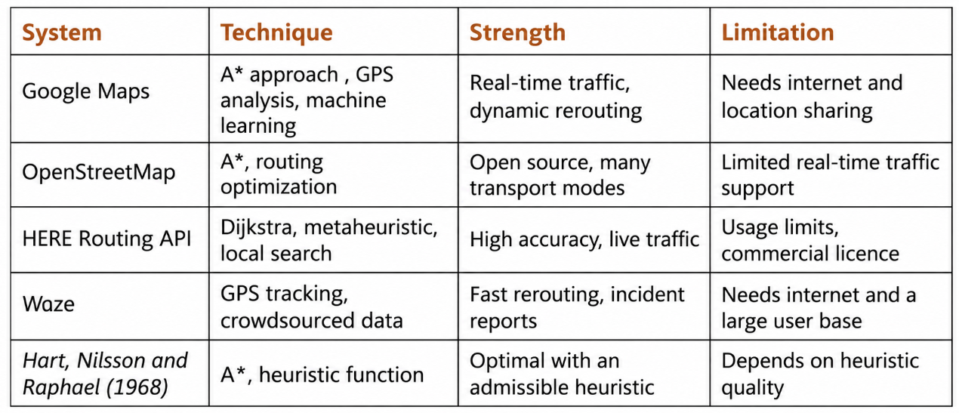
LITERATURE REVIEW
The A* algorithm provides a transparent approach to cost-based route finding, allowing each search step to be inspected and understood while existing navigation systems offer advanced route-planning features.

Slide 6
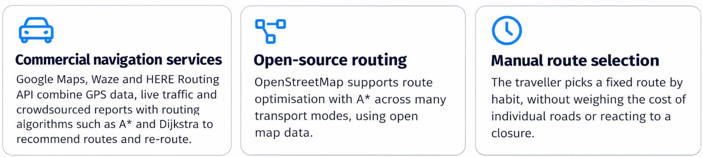
EXISTING SYSTEM
Existing navigation systems such as Google Maps and Waze provide route recommendations using geographical data, GPS tracking, and traffic information.
Key Features:
Provides multiple route options based on the selected destination.
Uses GPS location and live traffic information to recommend suitable routes.
Estimates travel time by analysing current road and traffic conditions.
Supports navigation across real-world road networks with alternative route suggestions.

Slide 7
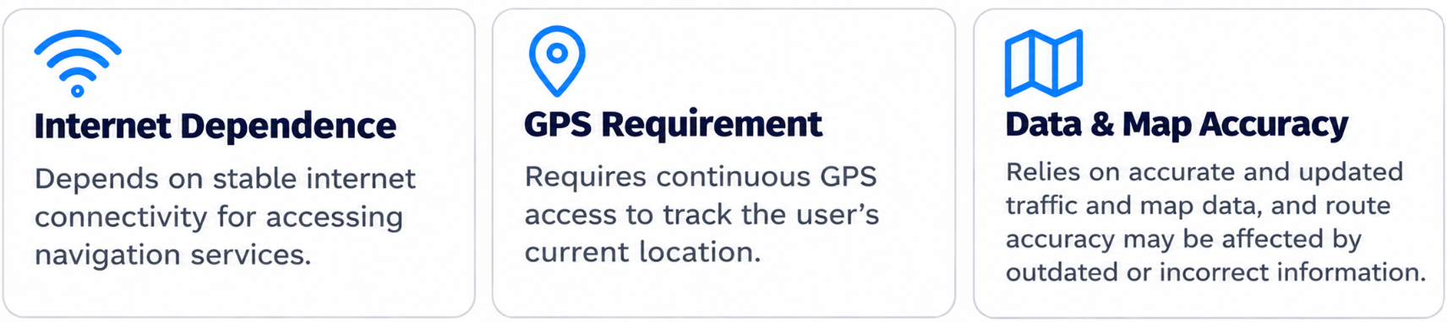
LIMITATIONS
Existing navigation systems have certain limitations, including dependence on internet connectivity, continuous GPS access, and the availability of accurate real-time traffic data.
Limitations:
Depends on stable internet connectivity for accessing navigation services.
Requires continuous GPS access to track the user's current location.
Relies on accurate and updated traffic data for route recommendations.
Route accuracy may be affected by outdated map information or incorrect traffic reports.

Slide 8
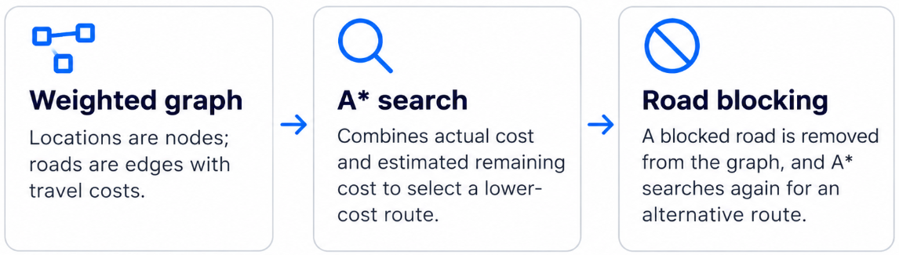
PROPOSED SYSTEM
Weighted graph representation of the road network.
A* algorithm for cost-based route finding.
Calculation of total route cost.
User selection of source and destination.
Custom road network input.
Road blocking and alternative route recalculation.
GUI-based route visualization and status display.

Slide 9
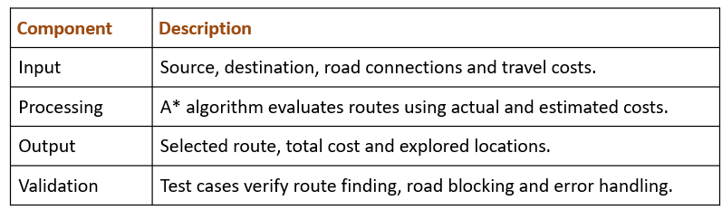
METHODOLOGIES
Four Methodologies Used:
Weighted Graph Construction – Represents locations and road connections with travel costs.
A Search* – Explores available paths to identify a suitable route.
Dynamic Road Updates – Updates the graph when roads are blocked and searches for alternatives.
Testing and Visualization – Validates results and displays route information through the GUI.

Slide 10
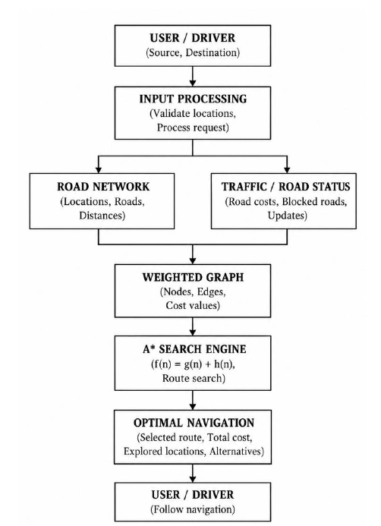
ARCHITECTURE DIAGRAM

Slide 11
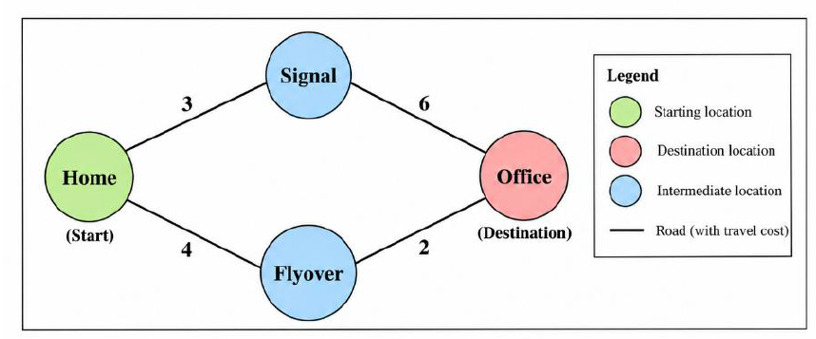
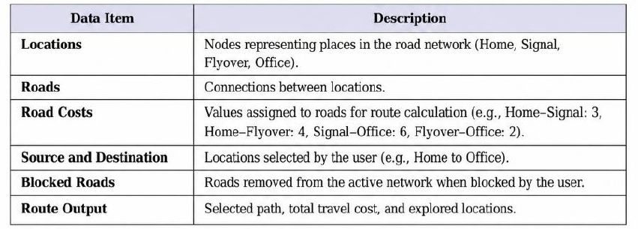
METHODOLOGY 1- WEIGHTED GRAPH CONSTRUCTION
Working Process:
Identify the locations in the road network.
Represent each location as a node.
Represent each road connection as an edge.
Assign a travel cost to each road.
Store the connections and costs in a weighted graph.
Update the graph when a road is blocked.
Output: A weighted graph containing locations, road connections, costs and road availability.

Slide 12
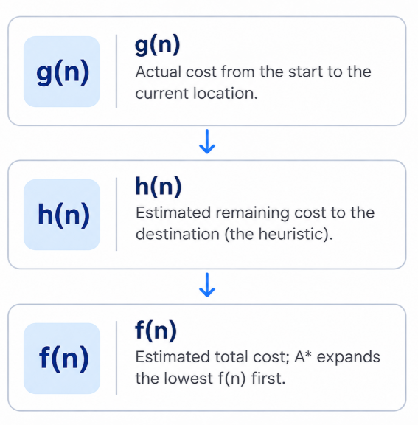
METHODOLOGY 2- A* SEARCH ALGORITHM
Working Process:
Receives the weighted graph, source, destination and heuristic values.
Calculates the estimated total cost using (f(n)=g(n)+h(n).
Selects the location with the lowest estimated total cost.
Explores neighbouring locations and calculates their path costs.
Updates the cost and path information if a better route is found until destination reached
Output: Selected route, total route cost, and explored locations, or a message indicating that no route was found.

Slide 13
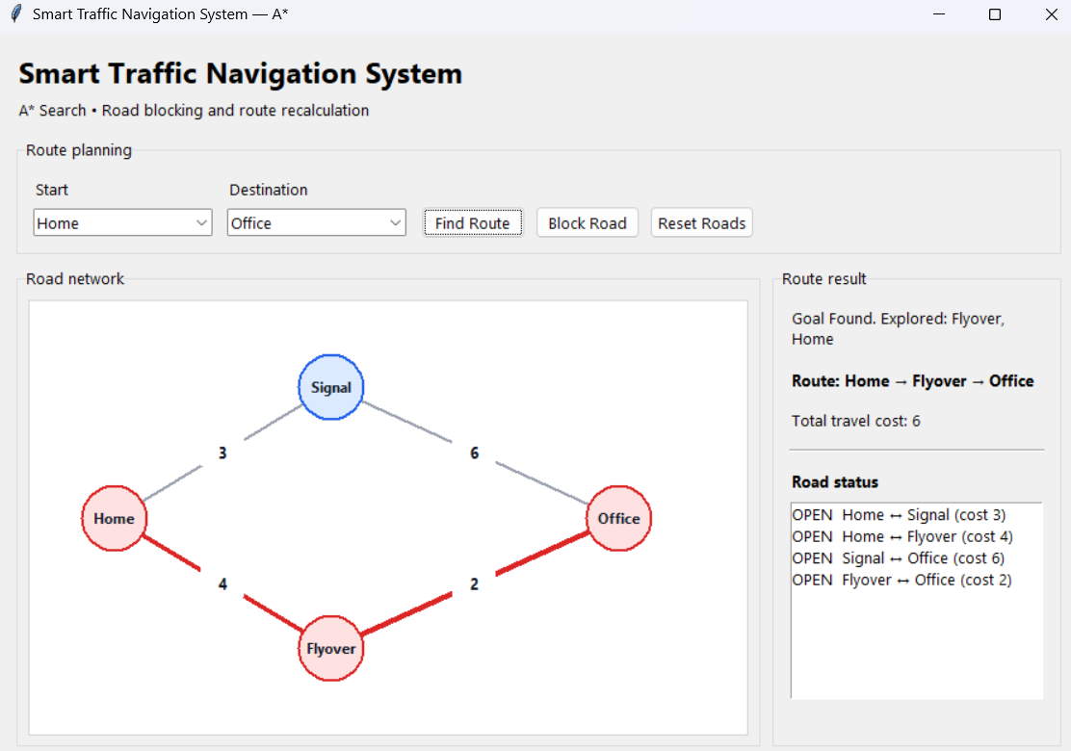
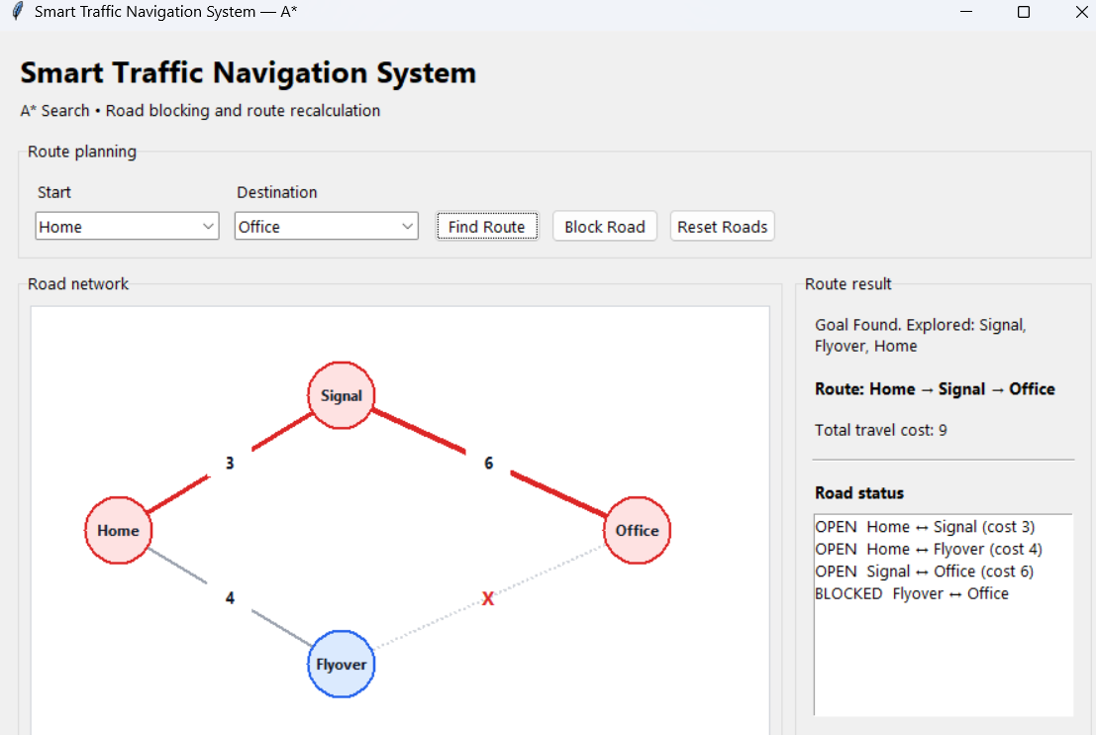
METHODOLOGY 3 - DYNAMIC ROAD UPDATES
Working Process:
Allows the user to select a road for blocking through the GUI and remove selected connection
Updates the road network to reflect the road's unavailability.
Runs the A* algorithm again using the updated graph.
Identifies an alternative route if one is available.
Provides an option to reset blocked roads and restore the original network.
Before: Home → Flyover → Office, cost 6
Output: Updated road network and recalculated route with its total cost.
Blocked: Home → Signal → Office, cost 9

Slide 14
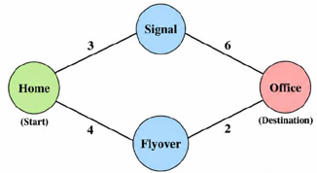
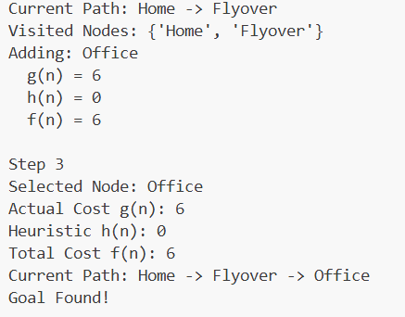
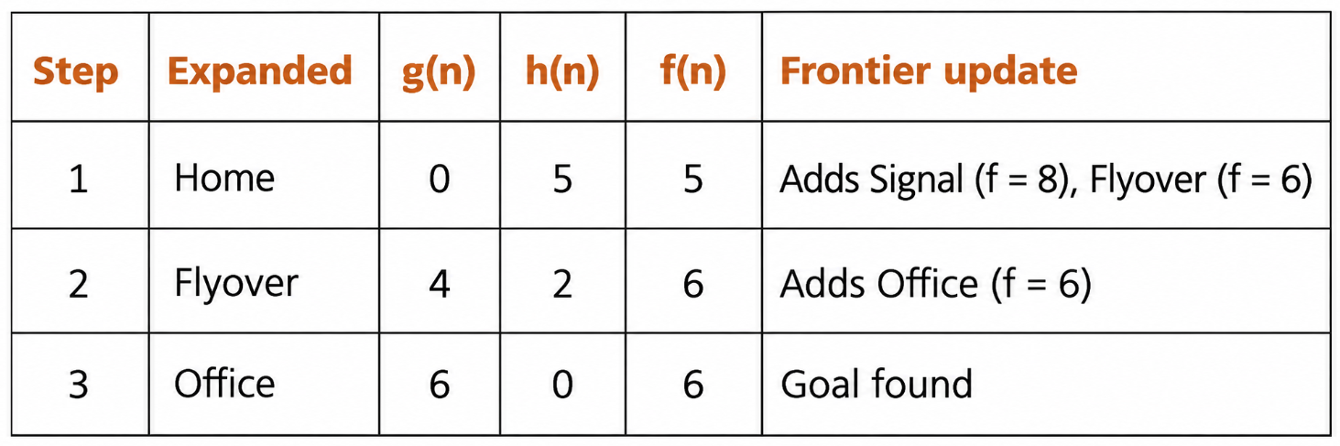
METHODOLOGY 4 – TESTING AND VALIDATION
Testing Process:
Test route finding between the selected source and destination.
Verify the route when source and destination are the same.
Check the system's response to invalid locations.
Test scenarios where no connected route exists.
Verify alternative route calculation after blocking a road.
Test road reset functionality and GUI output.
Working Example:
Output: Verified route calculation, road-blocking behaviour and graphical interface functionality.

Slide 15
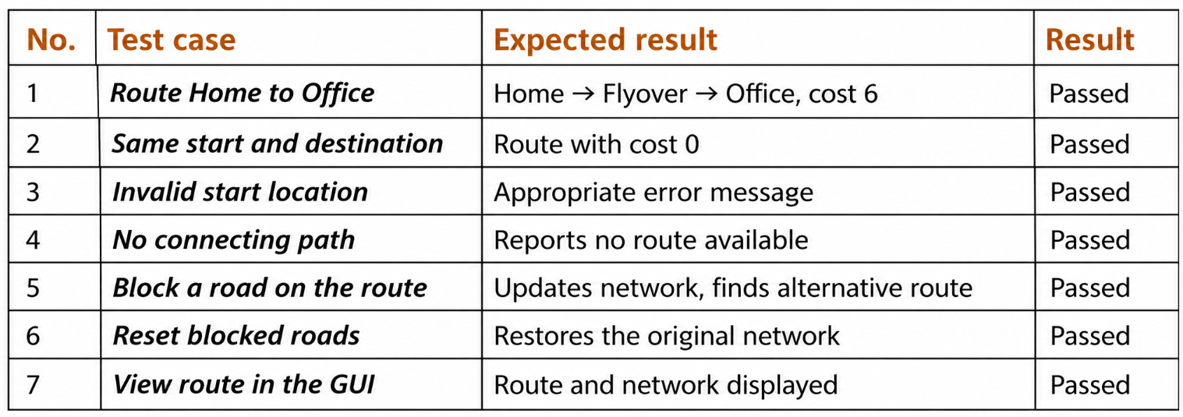
RESULTS (VALUES/TABLE)
The A* algorithm identified the expected route from Home to Office with a total cost of 6.
The system handled invalid locations and disconnected paths correctly.
Road blocking and reset operations worked as expected.
The GUI successfully displayed the road network and selected route.

Slide 16
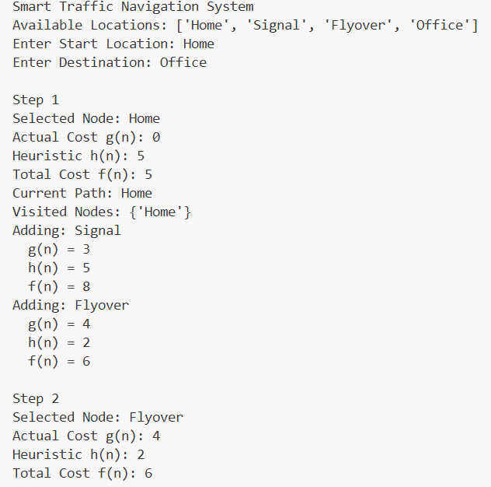
RESULTS – (SCREENSHOT)
Tkinter GUI: Route highlighted
Total cost: 6
Console trace of the A* search
The GUI offers Find Route, Block Road and Reset Roads, and lists each road as OPEN or BLOCKED

Slide 17
CONCLUSION
Successfully developed a Smart Traffic Navigation System using the A* search algorithm.
Represented the road network using a weighted graph with locations, connections and travel costs.
Identified suitable routes based on actual and estimated path costs.
Implemented road blocking and alternative route recalculation.
Developed a graphical interface to display routes, total costs and explored locations.
Validated the system through seven functional test cases, all of which passed.

Slide 18
FUTURE ENHANCEMENT
Real-time traffic information
GPS integration for the start point
Real geographical map integration
Automatic detection of road closures
Improved heuristic functions
Evaluation on larger road networks
Richer interface with route instructions

Slide 19
REFERENCES
[1] Russell, S. and Norvig, P. (2020). Artificial Intelligence: A Modern Approach. 4th ed. Pearson.
[2] Hart, P. E., Nilsson, N. J. and Raphael, B. (1968). ‘A Formal Basis for the Heuristic Determination of Minimum Cost Paths’. IEEE Transactions on Systems Science and Cybernetics, 4(2), pp. 100–107.
[3] Python Software Foundation. heapq — Heap queue algorithm.
[4] Python Software Foundation. tkinter — Python interface to Tcl/Tk.
[5] Python Software Foundation. unittest — Unit testing framework.
[6] Cormen, T. H., Leiserson, C. E., Rivest, R. L. and Stein, C. (2022). Introduction to Algorithms. 4th ed. MIT Press.

